Slide 1
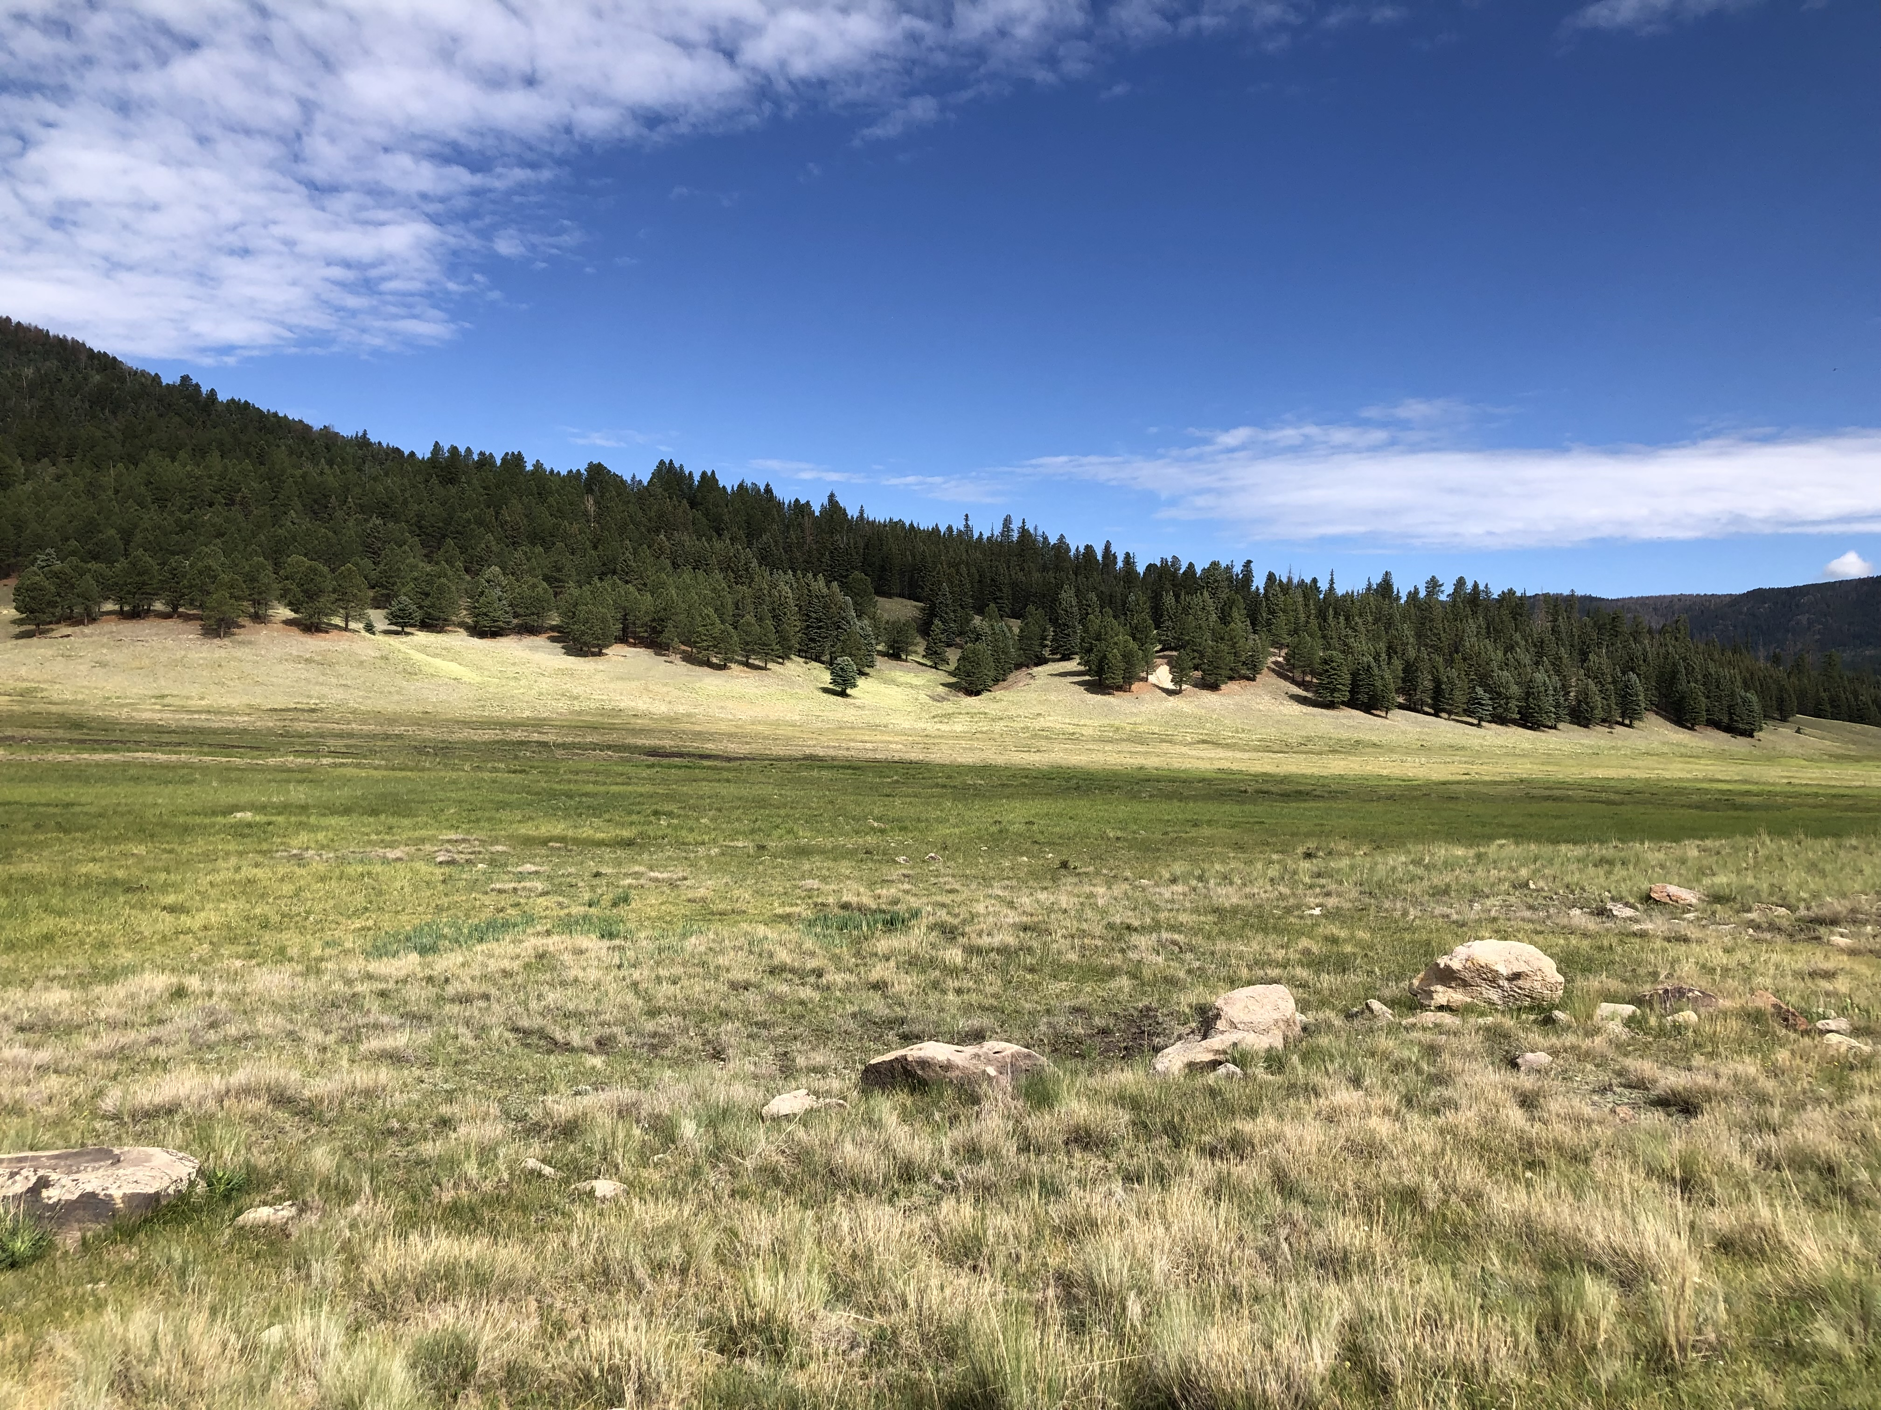
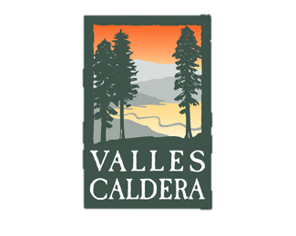


Impacts of Natural Diatomaceous Earth Abundance on Microarthropod Communities at Valles Caldera
  Justine Baca
  P.I - Anita Antoninka
  Graduate Mentor - Kara Gibson
  Northern Arizona University
  Hilton Tucson East – Tucson, Arizona
  April 23, 2022
Notes:
National Park Services logo. White bright and black

Slide 2
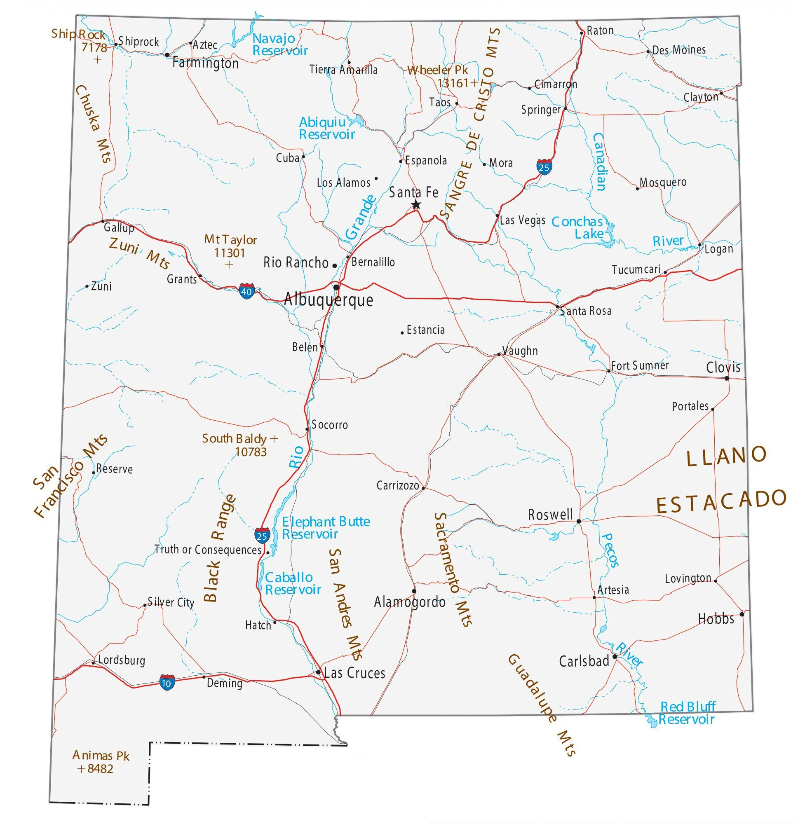


  Background
Valles Caldera National Preserve, New Mexico
Repeated lake formation from volcanic activity starting 1.25 Mya left a high abundance of fossil diatoms in the valleys and meadows
Source: GISGeography
Notes:
The location where we are examing microarthropods and diatoms are at Valles caldera national preserve. This place is very unique because of its volcanic activity that created lake and left behind high abndance of fossil diatoms that settle in lake beds in the valleys and meadows. Also Diatoms are found in waters such as rivers, streams and the ocean.
That fell out of the lake and the lake drain and left a lot of diatoms. Lake from 1 million ago to when the lake drain because dam burst left behind a lot of diatoms. Which diatom settles in the lake bed now we see national natural diatomeaous earth. Fossil diatomaceous

Slide 3
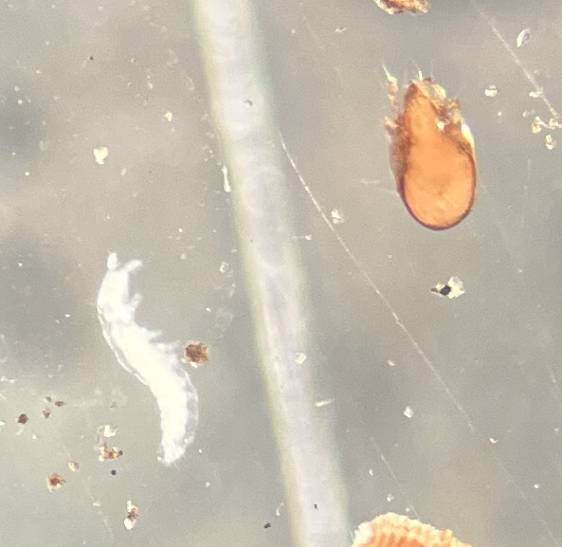
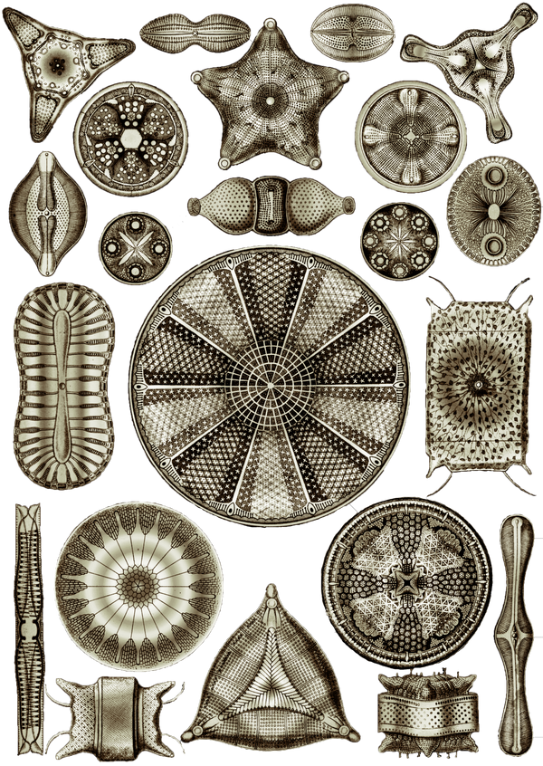
What are Microarthropods and Diatoms?
Microarthropods
  Mites (Acari)
  Springtails (Collembola)
  Others (ants, aphids…)
Diatoms
  Single cell organism that live in a “house of glass”
  Uses: pesticide (damages cuticle)
Source:Pixabay
Notes:
We will be focusing on two organizing and those are microarthropods and diatoms. Microarthropods are tiny tiny bugs and we caterogize them into mites, springtails and other (such as ants and aphids etc). Diatoms are single cell organism that live in a house of glass. They are used for pesticides in agriculture. These damage microarthropod cuticles which dehydrate them and they die.

Slide 4
Research Question : How does diatomaceous earth affect microarthropod populations in the Valles Caldera area?
Hypothesis: Higher diatom abundances negatively affect microarthropod populations
Objective: Examine microarthropod populations along a natural gradient of diatom abundance at Valles Caldera National Preserve in New Mexico
Covariates: Soil texture and soil organic matter content
Notes:
Since this is a natural gradient, we need to make sure there aren’t any other factors that are affecting microarthropod populations. The two covariants that we will be looking at is soil texture and soil organic matter. Soil texture is the proportion of sand, silt and clay that make up the soil itself, this can affect how populations move through the soil.. measuring organic matter in the soil which is food for these small creatures.

Slide 5
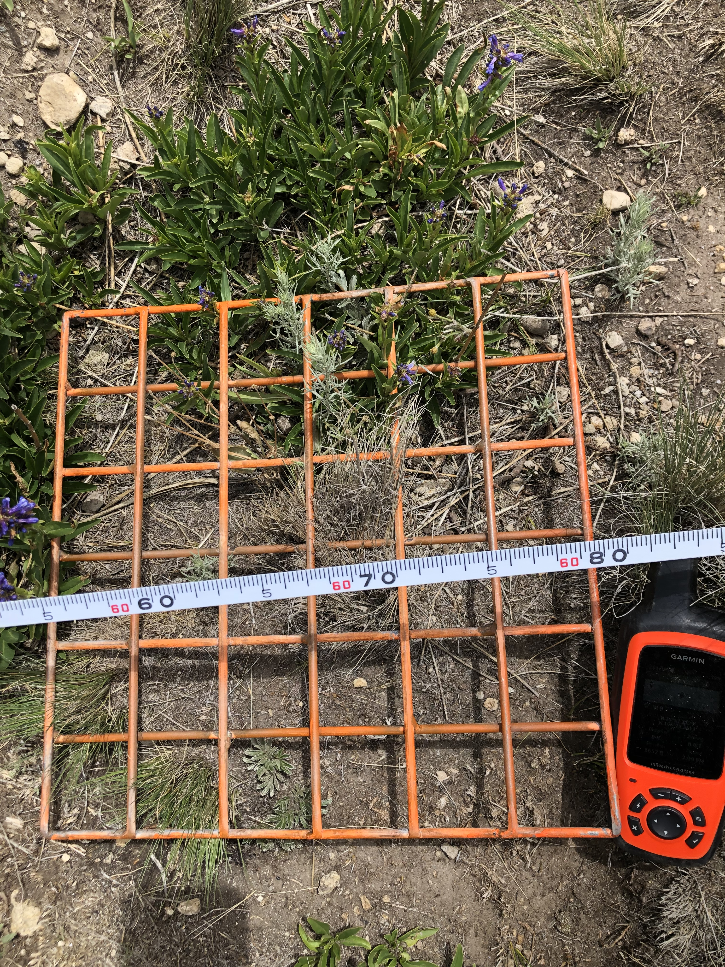
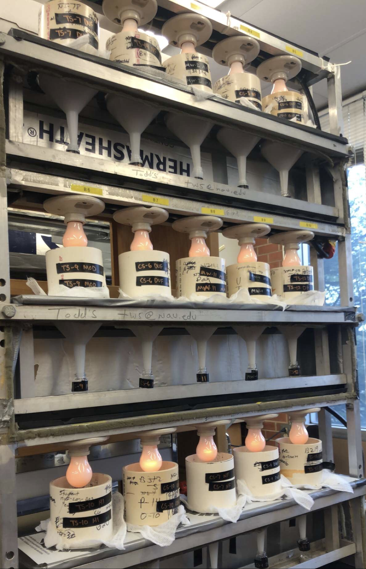
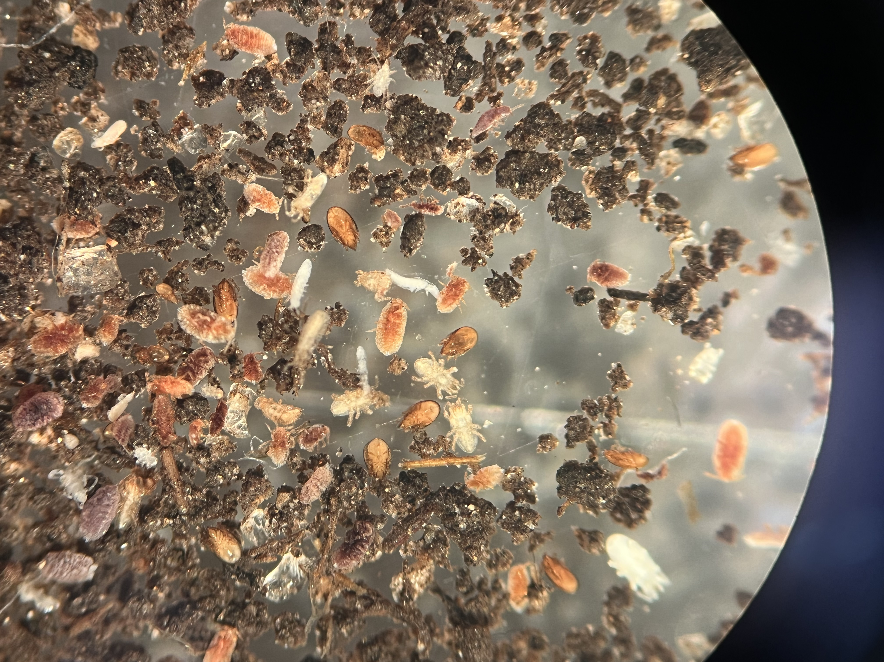
Methods
Soil collection
  Soil cores were collected moving from high to low diatom abundances
Microarthropod extraction and enumeration
  Extracted animals from soil cores then categorized as mites, springtails, or “others”
Notes:
For methods we start off with soil collection. Soil cores were collected from moving away from the highest diatom abundances. This resulted in 60 samples in total.

Slide 6
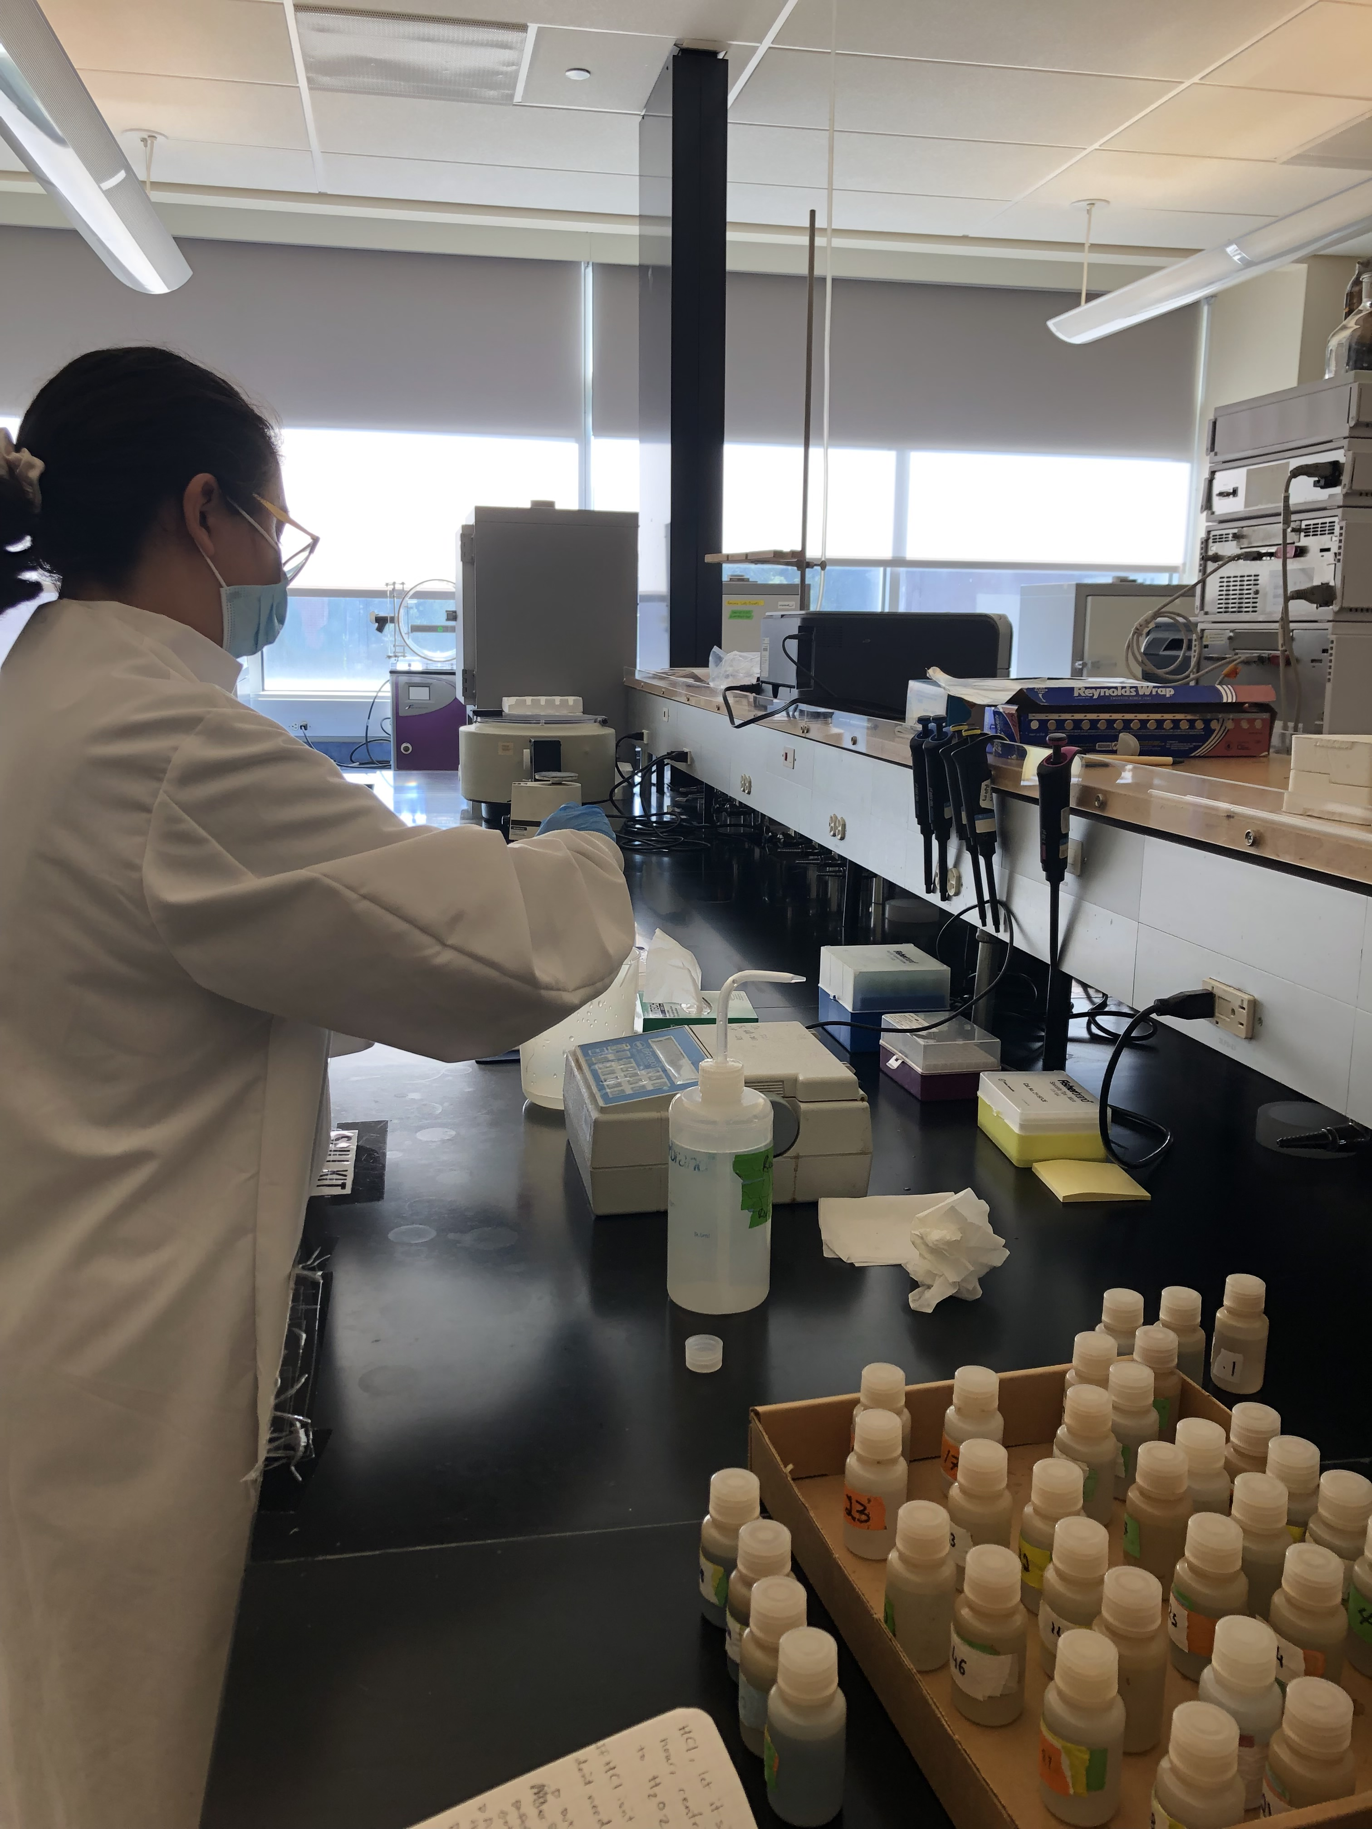
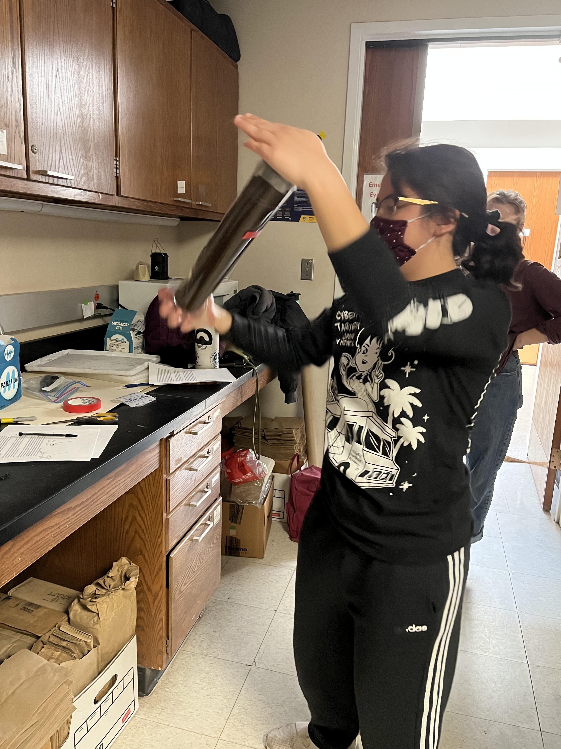
Methods
Diatom concentration – biogenic silica analysis method (Mortlock and Froelich, 1989)
Soil texture – hydrometer method (Gee and Bauder 1979)
Soil organic matter content – loss on ignition (Hoogsteen et al. 2015 and Donkin et al. 1991)
Notes:
Diatom concentration used the biogenic silic analysis method which measured concentration in a spectrophotometer. Soil texture used the hydrometer method which measures the percentage of sand slit and clay in the soil. Measuring soil organic content we burned organic matter to measure the weight of it and compare the lost of weight.

Slide 7
Results
Halfway through data collection
No significant relationship between mites & springtails and biogenic silica (BSI)
No relationship between soil texture, soil organic matter, and BSI
Notes:
Our covariates are not confounded with diatom abundance.

Slide 8
Conclusions
We have not detected any effect of natural diatomaceous earth on microarthropod communities … yet
Our results will inform about community assembly patterns of microarthropods in stressful environments and provide information for future management at Valles Caldera
Notes:
Some picture or something or cut it up to make it short to the point.

Slide 9
Acknowledgments
Anita Antoninka
Kara Gibson
Jordon Bright
Claire Johnson
Michael Sloan
Bob Parmenter
Jeremy Antoninka
Natalia Morales
Notes:
May not need to write down the organization and just put the logos. Should I organize them by last name

Slide 10
Thank You!

